Slide 1

Knowledge Graph Completion
with Adaptive Sparse Transfer Matrix
汇报人：黄婷
2016 AAAI

Slide 2
01
Introduction

Slide 3



Introduction
TransE
TransR
h: head entity
r : relation
t : tail entity
$$f_{r}(h,t)={‖M_{r}h+r−M_{r}t‖}_{2}^{2}$$
STransE

Slide 4
Introduction
Heterogeneous
some relations link many entity pairs (called complex relations) and others do not (called simple relations)
Unbalanced
some relations link many head (tail) entities and fewer tail (head) entities
Notes:
异质性会导致简单关系的过拟合，复杂关系的欠拟合。而不平衡性说明显然不能用同一个投影矩阵来对待头尾实体

Slide 5
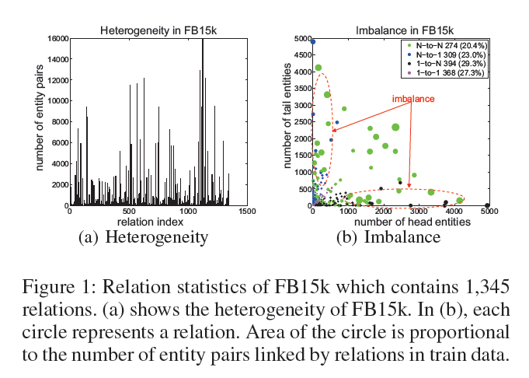
Introduction

Slide 6
02
Our Model

Slide 7
Our Model
Sparse Matrix
Sparse matrices refer to the matrices in which most entries are zeros. The fraction of zero elements over the total number of elements in a matrix is called sparse degree (denoted by θ).We use M(θ) to denote a matrix M with sparse degree θ.

Slide 8
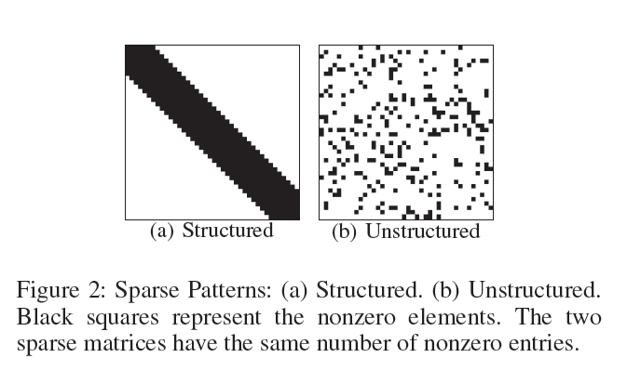
Our Model
Sparse Matrix

Slide 9
Our Model
Heterogeneous
We propose a model TranSparse(share), in which the sparse degrees of transfer matrices are determined by the number of entity pairs linked by relations and the two sides of relations share the same transfer matrices.
Unbalanced
TranSparse(separate)

Slide 10


Our Model
TranSparse(share)
Sparse degrees
Projected vectors

Slide 11



Our Model
TranSparse(separate)
Sparse degrees
Projected vectors
Score function for both

Slide 12
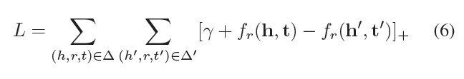
Our Model
Training Objective

Slide 13
An Interpretable Knowledge Transfer Model
for Knowledge Base Completion
汇报人：黄婷
2017 ACL

Slide 14
01
Introduction

Slide 15
Introduction
TransE
TransR
h: head entity
r : relation
t : tail entity
$$f_{r}(h,t)={‖M_{r}h+r−M_{r}t‖}_{2}^{2}$$
STransE

Slide 16
Introduction
Problem
稀有关系对应的投影矩阵可训练的三元组过少，泛化能力差
常见关系对应的投影矩阵可训练的三元组过多，泛化能力差
对投影矩阵的数量没有任何限制，逻辑上相关或概念上相似的关系可能有不同的投影空间，阻碍了统计规律的发现，共享和推广。

Slide 17
Introduction
Our Method
Proposing a novel knowledge embedding model which enables knowledge transfer by learning to discover shared regularities
Introducing a learning algorithm to directly optimize a sparse representation from which the knowledge transferring procedure is interpretable;

Slide 18
02
Interpretable Knowledge Transfer

Slide 19
Model
Concept
直观地说，许多关系彼此共享一些概念（concept），尽管它们在KB中被存储为独立的符号。
(somebody) won award for (some work)
(somebody) was nominated for (some work)

Slide 20
Model
Concept
这种现象表明，一个关系实际上代表了现实世界概念的集合，一个概念可以由几个关系共享。
以概念为单位构建投影矩阵，相比于之前以每个关系为单位构建投影矩阵，减少了参数。
但是，总的来说，我们并不了解那里存在着什么概念，以及它们是如何构成关系的。 因此，在ITransF中，我们建议从数据中同时学习这些信息以及所有的知识嵌入。

Slide 21


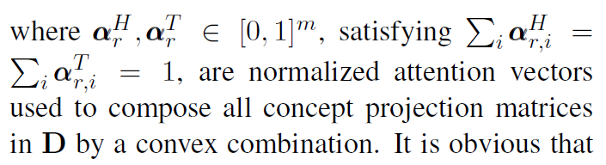
Model
Energy function
m : the pre-specified number of concept projection matrices

Slide 22
Model
Sparse attention vectors
利用密集的注意向量，在每次迭代中执行m个矩阵的凸组合在计算上是昂贵的。 而且，一个关系通常不是由现有的所有概念构成的。 而且，当注意力向量稀疏时，解释他们的行为往往更容易，并理解不同关系如何共享概念。

Slide 23
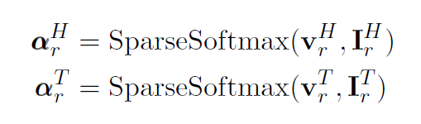
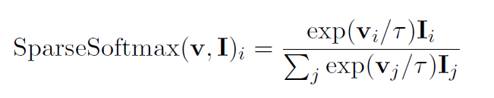
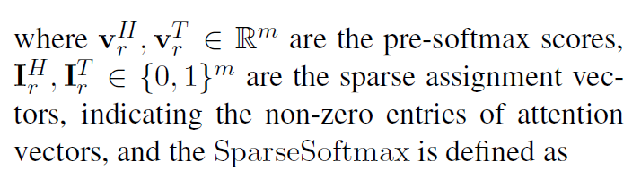
Model
Sparse attention vectors
本文实验证明用L1范数实现稀疏效果不好，故而采用L0

Slide 24
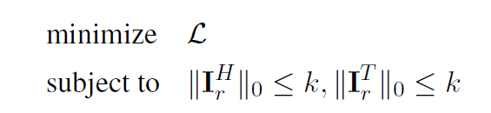
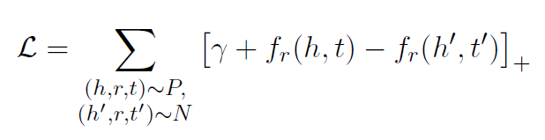
Model
Optimization
Notes:
L0 非零元素的个数

Slide 25
Block Iterative Optimization
Sparse partition | Dense partition
基于这个概念，近似算法的高层思想是对两个分区之一进行迭代优化，同时保持另一个分区的固定。
对密集分区采用SGD优化，难点在于稀疏分区，即L0约束下的优化问题
Notes:
分块迭代优化算法

Slide 26
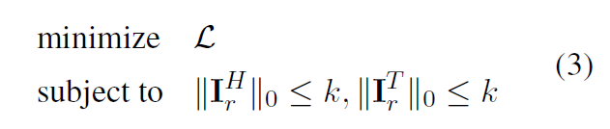
Block Iterative Optimization
L0约束下的优化问题
With parameters in the dense partition regarded as constant, the cost function is decoupled w.r.t. each relation r.
We only need to consider the optimization for a single relation r.

Slide 27
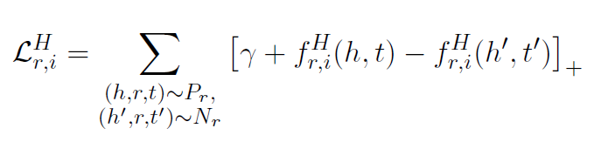


Block Iterative Optimization
L0约束下的优化问题
然而对于单个关系r来说，头尾实体都包含L0约束，联合优化过于复杂，因此选择简单近似方法代替。
对于一个关系r，假定头实体只有一个转移矩阵 。
$$D_{i}$$

Slide 28
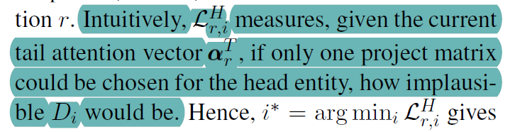
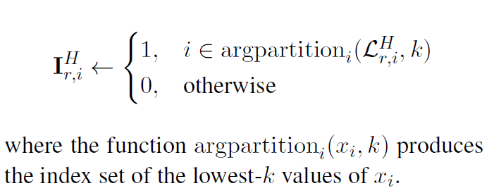
Block Iterative Optimization
L0约束下的优化问题

Slide 29
03
Experiments

Slide 30
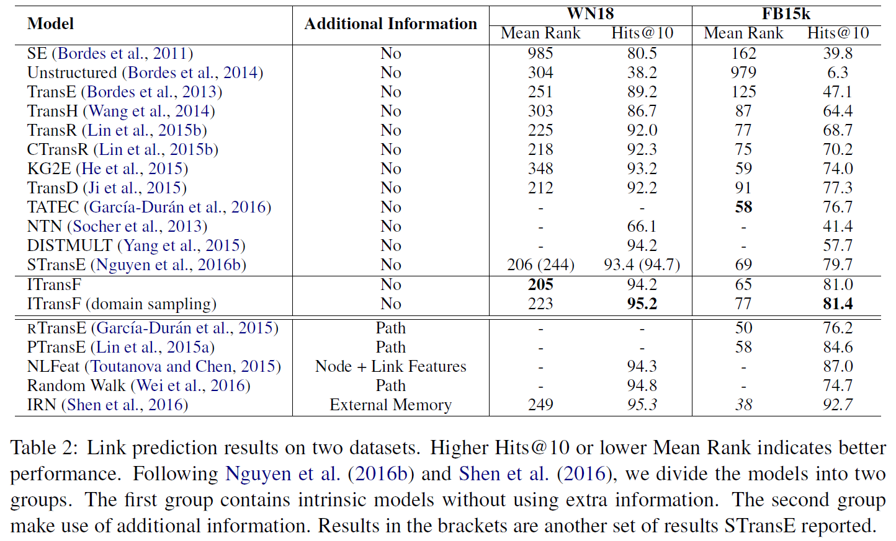
link prediction

Slide 31
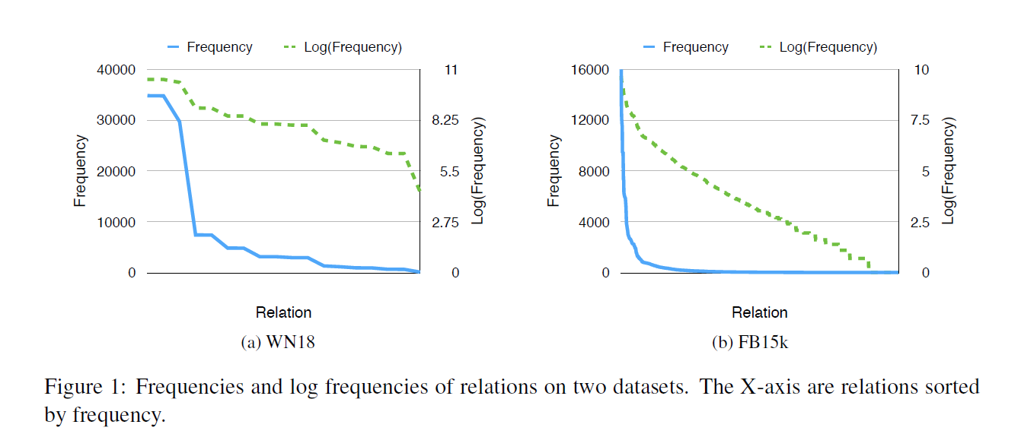
Performance on Rare Relations
在提出的ITransF中，我们设计了一个注意力机制来鼓励跨不同关系的知识共享。 当然，与稀有关系相关的事实应该从这种共享中受益最多，从而提升整体表现。 为了验证这个假设，我们调查了我们模型在不同频率关系上的表现。
Notes:
双曲线分布

Slide 32
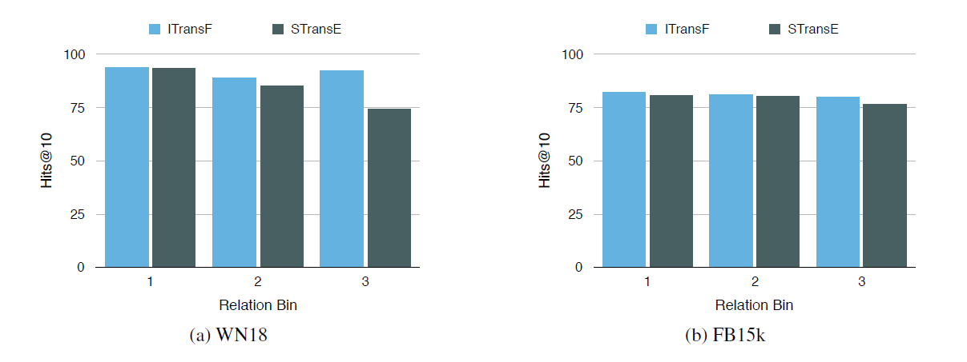
Performance on Rare Relations
Notes:
双曲线分布

Slide 33
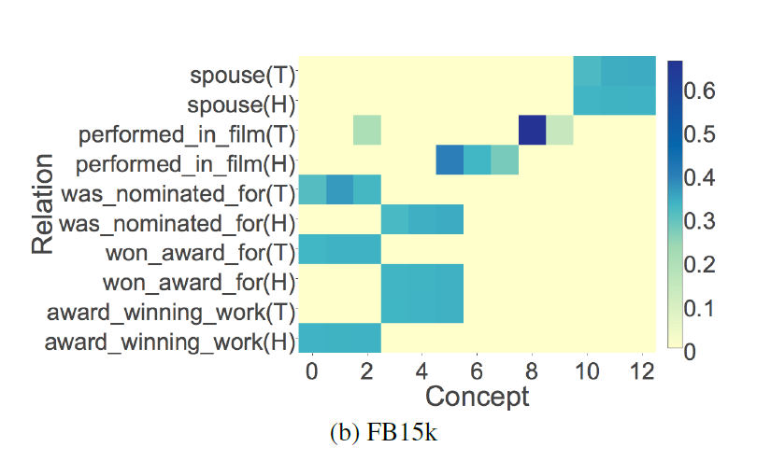
Interpretability
Notes:
双曲线分布

Slide 34
Thank You！
PPT模板下载：www.1ppt.com/moban/ 行业PPT模板：www.1ppt.com/hangye/
节日PPT模板：www.1ppt.com/jieri/ PPT素材下载：www.1ppt.com/sucai/
PPT背景图片：www.1ppt.com/beijing/ PPT图表下载：www.1ppt.com/tubiao/
优秀PPT下载：www.1ppt.com/xiazai/ PPT教程： www.1ppt.com/powerpoint/
Word教程： www.1ppt.com/word/ Excel教程：www.1ppt.com/excel/
资料下载：www.1ppt.com/ziliao/ PPT课件下载：www.1ppt.com/kejian/
范文下载：www.1ppt.com/fanwen/ 试卷下载：www.1ppt.com/shiti/
教案下载：www.1ppt.com/jiaoan/ PPT论坛：www.1ppt.cn

